Slide 1
Introduction to Data Analysis & Visualization with R
Brian Zelip
Emerging Technologies Librarian
bzelip@hshsl.umaryland.edu

Slide 2
Agenda of Workshop
R basics
Installation
Practice
Plotting data
Analyzing data
Cleaning data
Scope of Workshop
Demonstration over explanation of statistical concepts

Slide 3
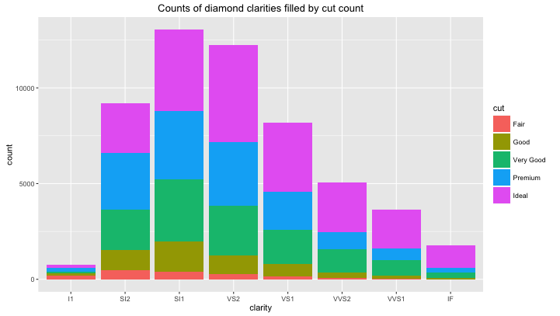
Examples of Workshop Output

Slide 4
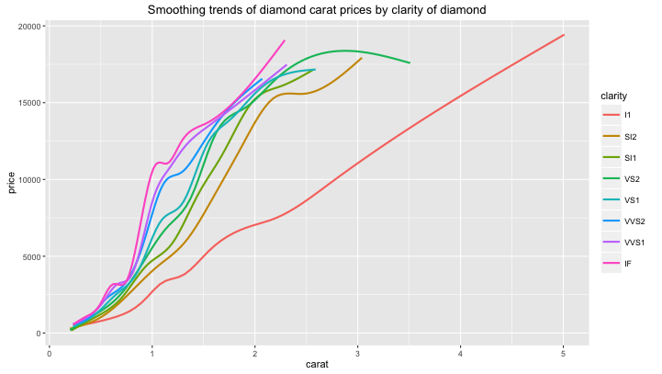
Examples of Workshop Output

Slide 5
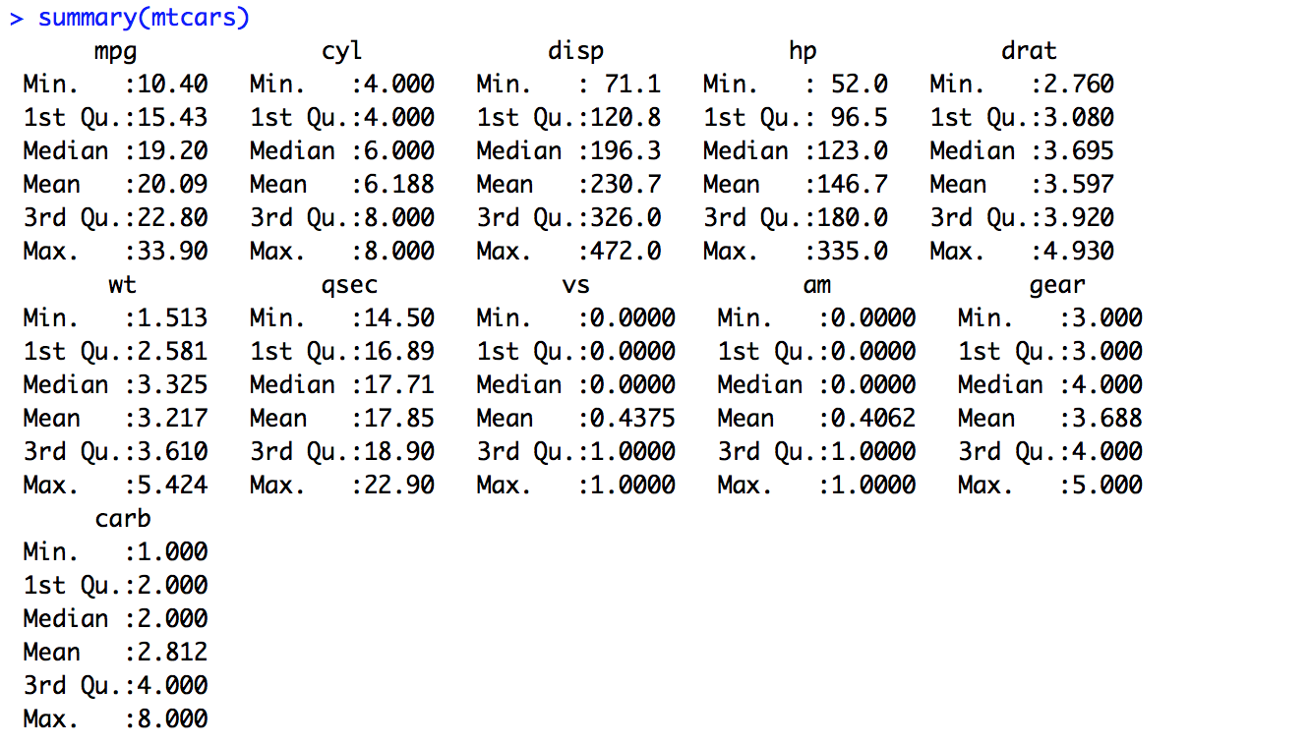
Examples of Workshop Output

Slide 6
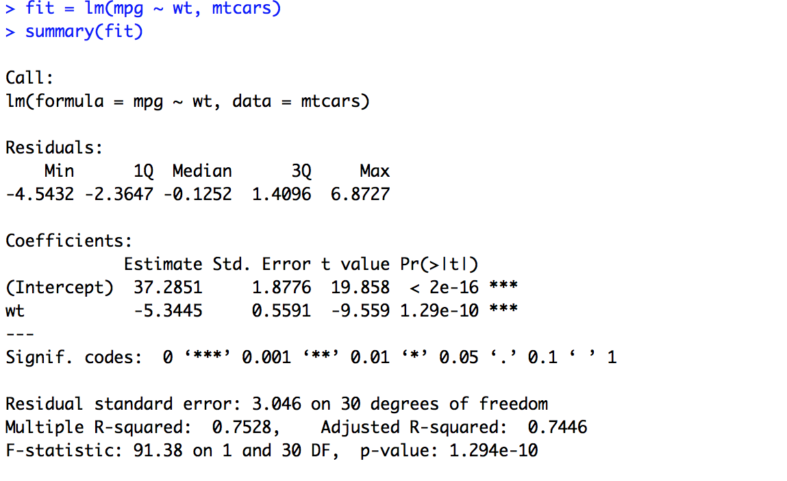
Examples of Workshop Output

Slide 7
About R
https://www.r-project.org/
Free and open source software
Runs on Windows, OSX, GNU/Linux, FreeBSD, and more
Created in ‘93 as a free software version of the S language
R is a programming language and environment
Default install provides “base R” suite of packages, or tools
Install more packages via CRAN
CRAN = Comprehensive R Archive Network
https://cran.r-project.org/
provides downloads for R and most packages
provides documentation for all available packages
Very active global community of users and developers

Slide 8
R’s Package Ecosystem
base R
3rd party
CRAN packages
3rd party packages not yet in CRAN

Slide 9
Programming Features of R
Interpreted language (commands are executed directly and output is provided immediately)
Accessible via:
a command line
the R application itself
3rd party graphical user interfaces, like RStudio
Supports procedural programming with functions and some object-oriented programming
data structures include:
vectors
matrices
arrays
data frames
lists

Slide 10
RStudio
https://www.rstudio.com/
Free and open source software
Most popular integrated development environment (IDE) for R
Combines the power of the command line with the usability of a graphical user interface
Provides the same experience across operating systems (which the R application and other GUIs do not)
Requires prior R installation

Slide 11
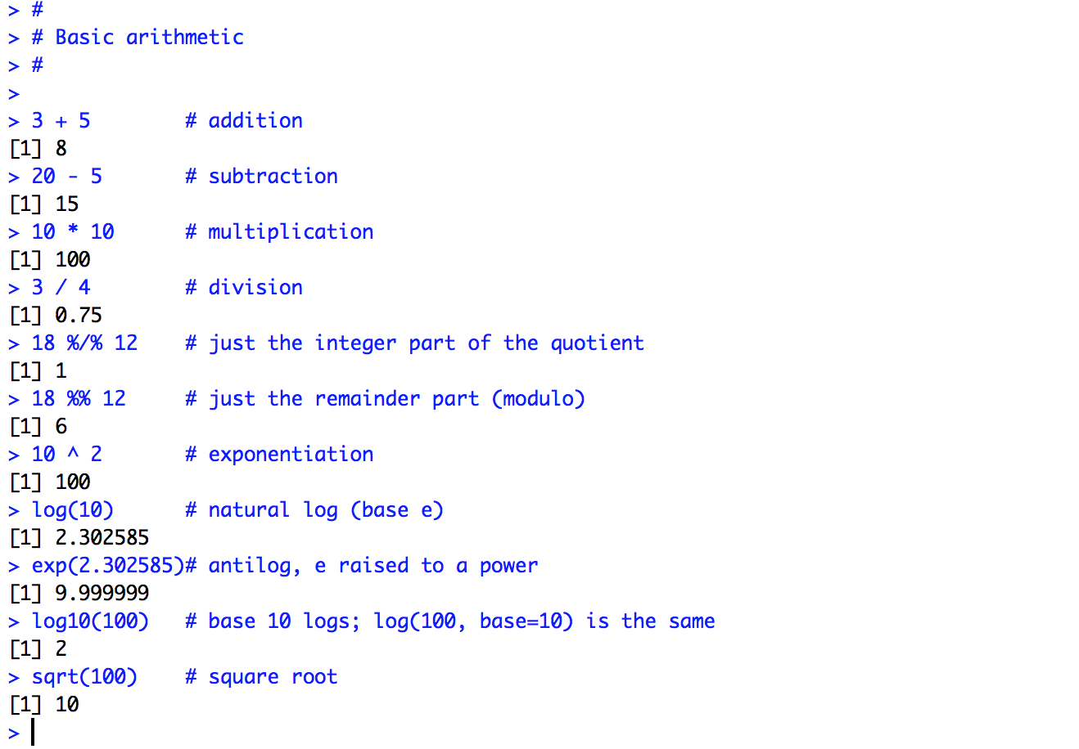
Brief Look at R Syntax for Basic Calculation

Slide 12
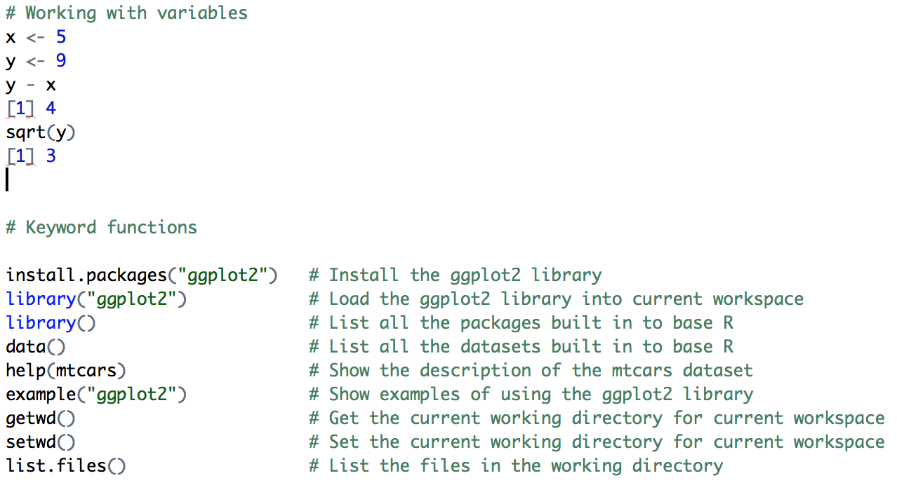
Brief Look at More Useful R Syntax

Slide 13
INSTALLATION
R, https://cran.r-project.org/
RStudio, https://www.rstudio.com/

Slide 14
HANDS-ON DEMO

